Slide 1





“PERSONALIZED CREDIT SCORE”
SJB Institute of Technology
Project Review I
on
Presented By
Under The Guidance of
Shreyanshi [1JB13CS148]
Shriyanka B V [1JB13CS149]
Shubham Verma [1JB13CS152]
Sujeet Kumar [1JB13CS160]
Dr. Srikantaih K. C.
Professor
Department of CSE

Slide 2
Introduction
A number ranging from 300-850
It represent a person’s credit-worthiness
Higher the number, more the credit-worthiness
Used to evaluate potential risk in lending money to lenders
Calculated and maintained by CIBIL in India
Adopted by banks and credit card companies

Slide 3
Literature Survey
S. No. | Paper Name | Year | Description | Publisher
1 | Credit Rating in India: A Study of Rating Methodology of Rating Agencies | 2011 | To assess the consistency in rating methodology of each individual rating agency by taking companies | Global Journal Of Management And Business Research
2 | The impact of credit scoring on consumer lending | 2013 | Adoption of automated credit scoring and the changes it enabled in lending at a large finance companies. | GRAND Journal Of Economics.

Slide 4
S. No. | Paper Name | Year | Description | Publisher
3 | Research and application of credit score based on decision tree algorithm | 2011 | Introduction to the basic process of decision tree algorithm | College of Finance, The University of Zhejiang Gongshang
4 | A study of awareness about CIBIL and credit information reports among customers at commercial banks | 2014 | To study the awareness level of CIBIL among customers at commercial banks. | International Journal of Research Aspects of Engineering and Management

Slide 5
Problem Statement
Alternative payment date of contractual agreements are not taken into consideration
No ready access nor it is freely available
Low awareness on improving individual’s credit score
Financial Institutions cannot proactively identify consumers who are likely on their loans
Social influence of individual plays no role in the calculation of their credit score
Online contractual payments do not contribute in building credit score

Slide 6
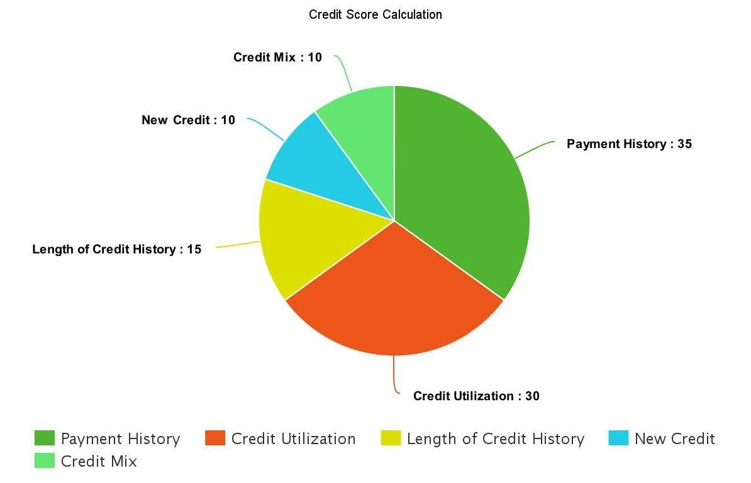
Existing System

Slide 7
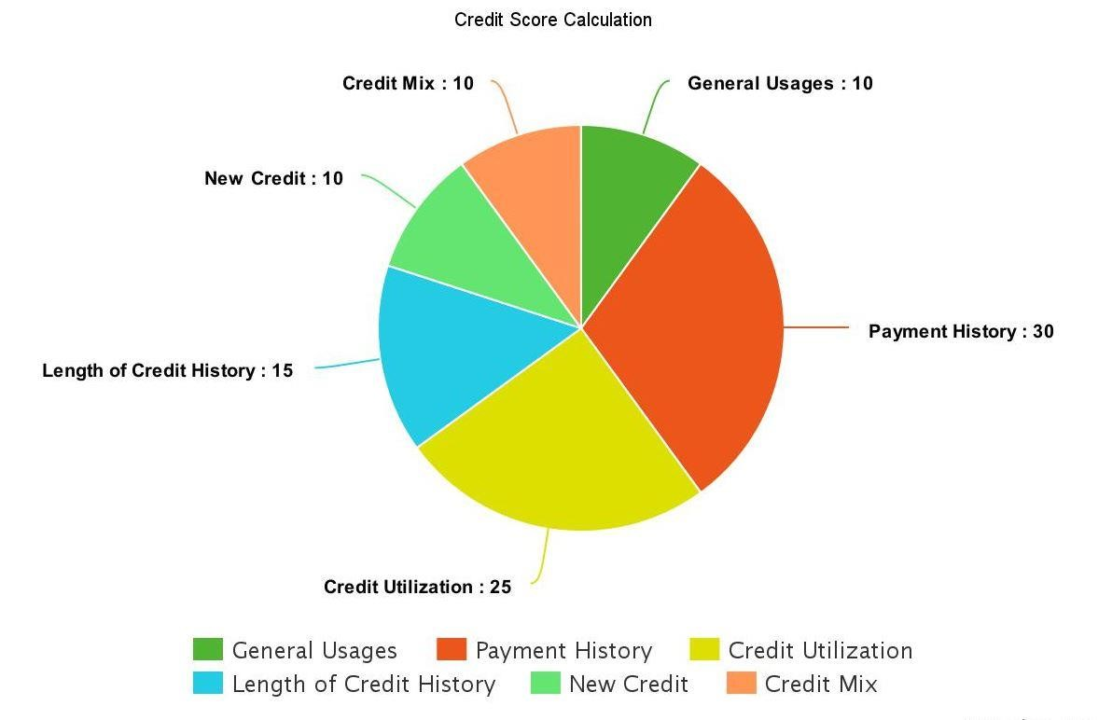
Proposed System

Slide 8
Requirement Analysis
Software Requirement | Hardware Requirement
Android Studio Android SDK Android Emulator XAMP/Online Free Web Hosting & MySQL Database Front End - XML and Javascript Back End – PHP and MySQL | 6GB RAM Android Phone 20GB Hard Disk

Slide 9
Functional Requirement
Functional requirement are those that refers to the functionality of the system, i.e. what services admin provides to the users.
Admin Session
Admin can register user who signs up with the application.
Admin can fetch the detail of the customer based on the detail provided by the user.
User Session
User gets a platform to view his credit score.
User can view the benefits based on his credit score.

Slide 10
Non-functional Requirement
Non-functional requirements are the other information needed to produce the correct system. These are constraints within which the system must work. These are listed below:
Usability: Both user and admin can be able to use the system with ease and comfort.
Reliability: The output of the system should be reliable to the user, i.e. system should deliver correct output and helpful information.
Performance: Performance of the system should be good and fast.
Maintainability: The System should be optimized for supportability, or ease of maintenance as far as possible.

Slide 11
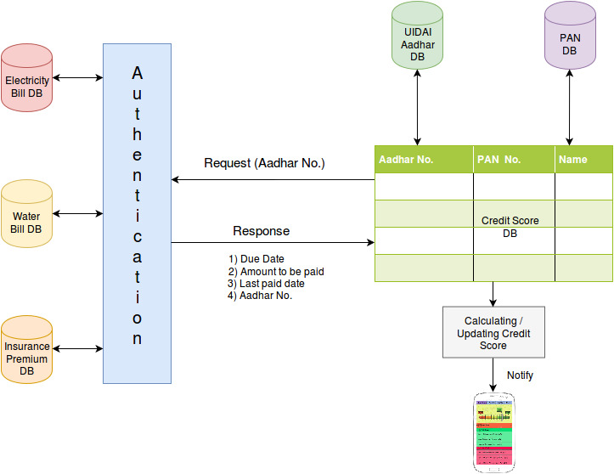
System Design

Slide 12
Plan of Action
☑ Literature Survey on 26-Feb-2017
☑ Synopsis on 02-Feb-2017
☑ Requirement Analysis on 04-March-2017
□ Design in process and will be completed by 20-March-2017
□ Implementation by 15-April-2017
□ Testing by 10-May-2017

Slide 13
REFERENCES
[1] J. Simon and P.J. Simon, Head First Android development. Sudbury, MA, UnitedStates: O’Reilly Media, Inc , USA, 2011.
[2] Jackson, W. (2013). Learn Android app development. Berkeley, CA: SPRINGER A PR TRADE.
[3] Sierra, K., Bates, B. (2005). Head first java: [your brain on java – a learner’s guide] (2nd ed.). Boston, MA, United States: O’Reilly Media, Inc, USA.
[4] K. Jamsa, Introduction to web development using Html 5. Sudbury, MA, UnitedStates: Jones and Bartlett Publishers, 2013.
[5] R. Chopra, Database management system (DBMS): A practical approach: Concepts, principals, case studies, experiments. New Delhi: S Chand & Co, 2010.

Slide 14


